Slide 1
AWT PJ Video Streaming Mixer Library
Alexander Futász

Slide 2
Your tutors/counselors
Alexander Futász, alexander.futasz@fokus.fraunhofer.de

Slide 3
Intro
Adaptive streaming video standards are the norm for anything that is video and is streamed over the internet nowadays
For streaming adaptive video there are two main standards, MPEG-DASH and Apple‘s HLS – both similar in how they work
Instead of a single video file being transferred to clients, adaptive streaming works by splitting video into smaller segments, each segment being its own file. These video segment files are referenced by playlist files that specify time, duration and order of segments
By providing playlists and video segments playback becomes much more flexible and robust as it provides a number of benefits
Splitting of video and audio tracks, to e.g. provide multiple different audio tracks with different languages
Provide multiple video tracks with different resolution and bitrate to accomodate (temporary) bandwith bottlenecks during transfer
Being able to seamlessly switch between tracks to e.g. 720p, 1080p or 4K video resolution

Slide 4
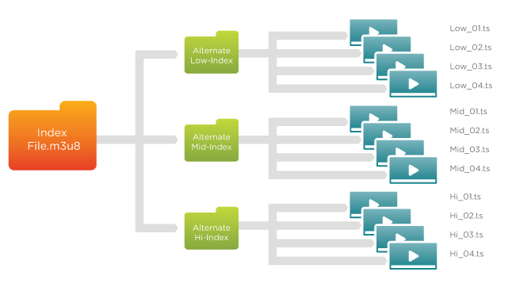
HLS

Slide 5
Video Streaming Mixer Library
In order to create e.g. playlists consisting of multiple existing different video streams it is needed to make sure that the different video stream sources are all compatible in regards to video resolution and bitrate and can be combined into a single video stream.
Your tasks:
Parse input HLS manifests into fitting object representation
Design and implement an algorithm that identifies matching representations based on e.g. resolution, bitrate etc.
Output must be a HLS manifest including all compatible inputs that matched
Implement as a library component that can be used in other applications as a dependency
Implement at least two separate strategies/algorithms for matching
Given an array of manifest inputs, all representations/tracks from the first manifest input need to be in the output manifest and only include the other manifest inputs if matching presentations are found
The output manifest must contain only the intersection of all representations, if nothing matches the output could be empty
Print warning messages on console for non-matching representations, print error messages to console in case nothing matched, etc

Slide 6
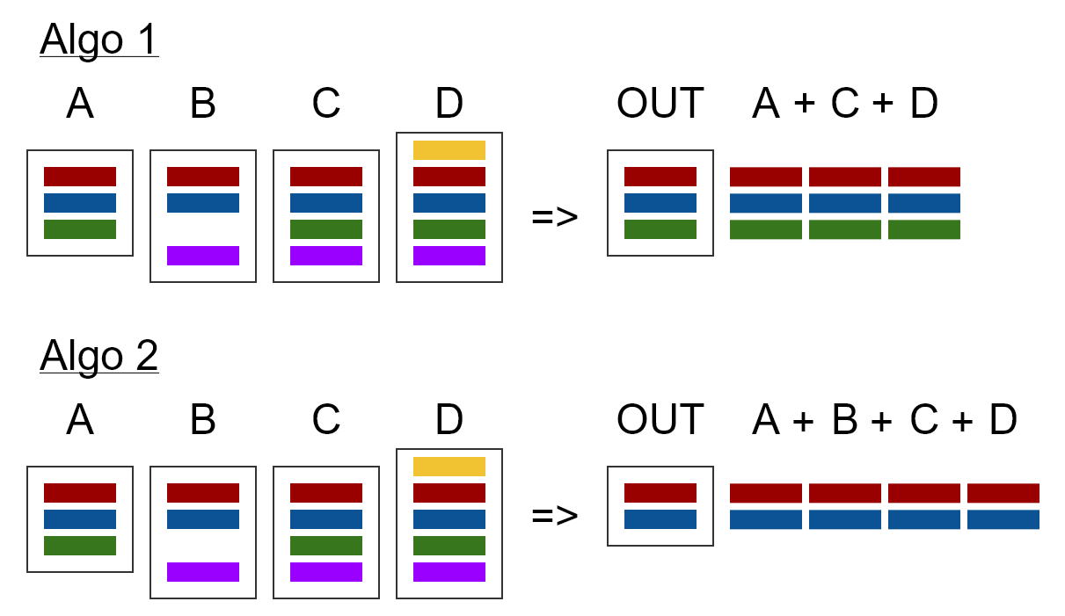

Slide 7
For strategy 1, we have three variant playlists and the output also contains only three playlists. But these playlists are now longer, because they concatenate the matching playlists into a single red, a single blue and a single green playlists with all the segments from inputs A, B, C and D. While playlists purple and yellow use e.g. a different resolution and are not present in the first input A and thus are not used.
For strategy 2, we see that only the intersection of variant playlists from all inputs is used. Two variants with the same resolution have been identified across all inputs, red and blue, so only two variant playlists should be in the output manifest. Each one will include all concatenated segments from all inputs matching the respective representation.
Finally, handling the playlists that have been identified as belonging to the same representation (resolution, bitrate). Realize that the output manifest, that needs to be written, can never have more media playlists than any of the input sources by itself. Do not add more media playlists to the master manifest. Instead, given the found media playlists using the same representation, concatenate these into a single media playlist and only that new playlist should be part of the master manifest output.

Slide 8
Resources
https://bitmovin.com/adaptive-streaming/
https://www.wowza.com/blog/adaptive-bitrate-streaming
HLS https://datatracker.ietf.org/doc/html/rfc8216
https://hlsanalyzer.com/
https://developer.apple.com/documentation/http_live_streaming/about_apple_s_http_live_streaming_tools

Slide 9
Organizational
Secretary: https://www.ods.tu-berlin.de/menue/fachgebiet_open_distributed_systems/ueber_uns/administrative_assistenz_assistance_office_chair/
Yvonne Schoknecht, yvonne.schoknecht@tu-berlin.de
MOSES: https://moseskonto.tu-berlin.de/moses/modultransfersystem/bolognamodule/beschreibung/anzeigen.html?number=40253&version=5&sprache=1
ISIS: https://isis.tu-berlin.de/course/view.php?id=28989
use https://git.tu-berlin.de/
 |  | Date | Upload for slides/video until
Workshop 1 | Presentation of the project topics, possible solutions and roadmap | 17.05.2022 | 10.05.2022 EOB
Workshop 2 | Report on project progress | 14.06.2022 | 07.06.2022 EOB
Workshop 3 | final presentation of the improved project solution | 19.07.2022 | 12.07.2022 EOB
Final Submission | final deadline for the documentation and source code | 31.07.2022 | 31.07.2022 EOB

